Slide 1
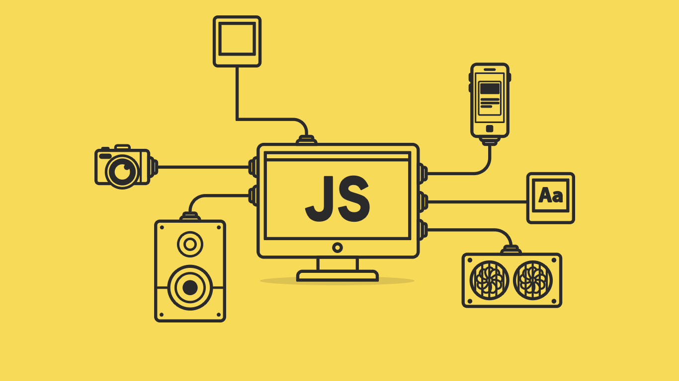
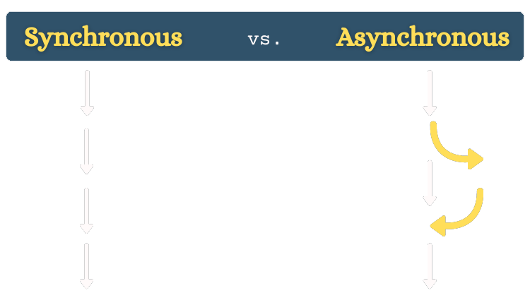

Slide 2
About today…
JavaScript
Promise
Fetch API with Promise

Slide 4
Introduction to Asynchronous JavaScript
Synchronous vs. Asynchronous
Synchronous
Tasks are executed one after another
Asynchronous
Tasks are executed independently, allowing for other operations to continue
while waiting
Why Asynchronous Programming?
To handle operations like fetching data from a server, reading files, or any I/O operations without blocking the main thread

Slide 5
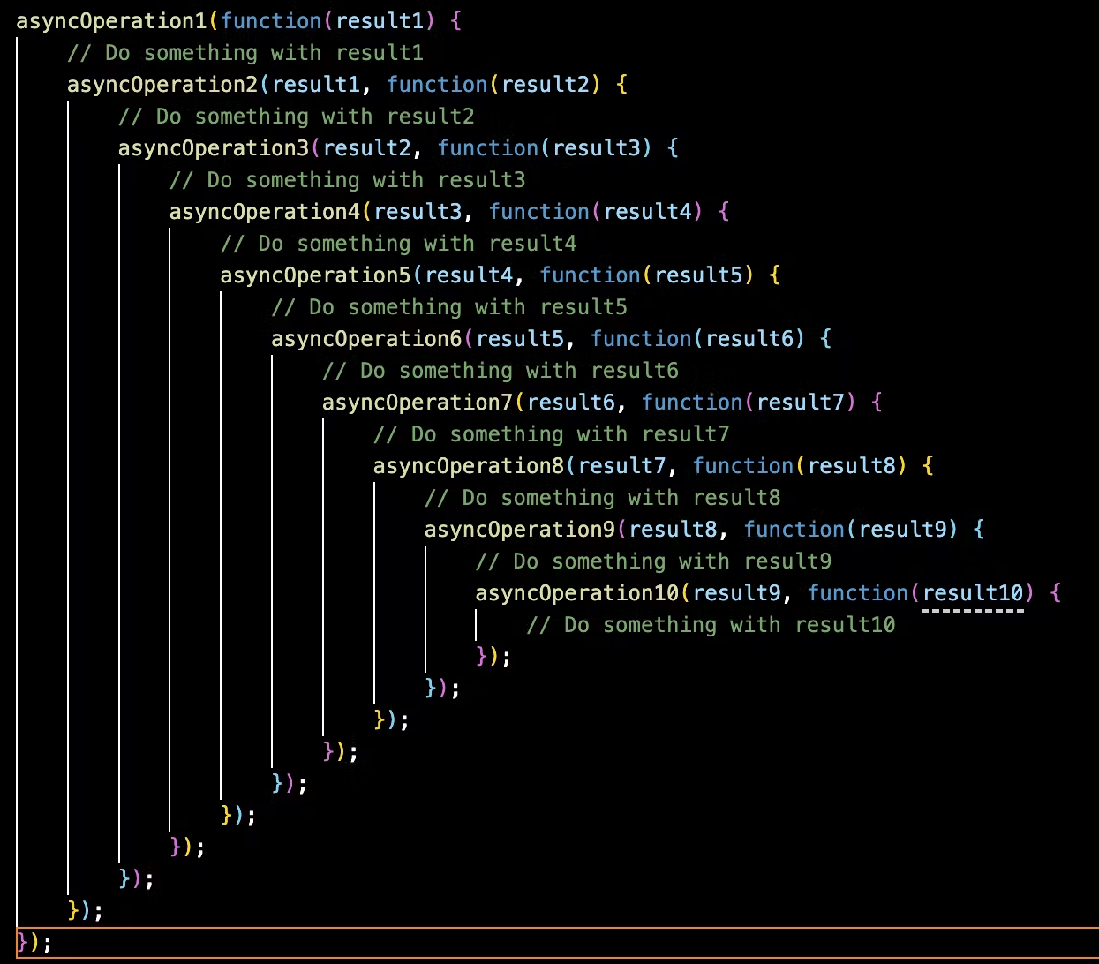
The Need for Promises
Callback Hell
Problems with Callbacks
Hard to manage
Difficult to handle errors
Callback hell

Slide 6

What are Promises?
Definition
A Promise is an object representing the eventual completion or failure of an asynchronous operation
States of a Promise
Pending
Initial state, neither fulfilled nor rejected
Fulfilled
Operation completed successfully
Rejected
Operation failed
Example

Slide 7
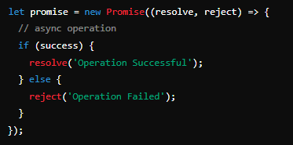
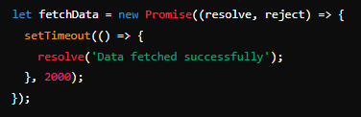
Creating Promises
Syntax
Example

Slide 8

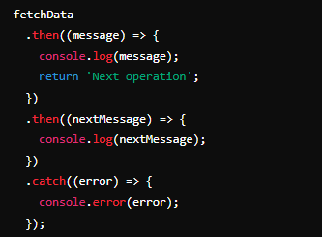

Consuming Promises with .then() and .catch()
Using .then() for Success
Chaining Promises
Using .catch() for Errorss

Slide 9
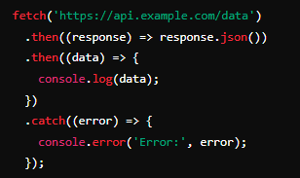
Example: Fetch API with Promises
Using Fetch API
Explanation
Fetch returns a Promise
response.json() returns a Promise that resolves to JSON data

Slide 10
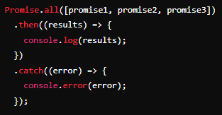
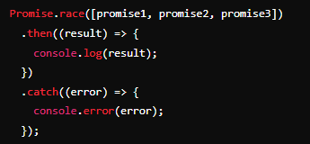
Promise.all() and Promise.race()
Promise.all()
Waits for all promises to be resolved or any to be rejected
Promise.race()
Resolves or rejects as soon as any of the promises are resolved or rejected

Slide 11
Promise.all() and Promise.race()
Promise.all()
Waits for all promises to be resolved or any to be rejected
Promise.race()
Resolves or rejects as soon as any of the promises are resolved or rejected

Slide 12

What are the three states of a Promise?
Pending, Fulfilled, Rejected
What is the primary purpose of using Promises in JavaScript?
To handle asynchronous operations and avoid callback hell
How do you handle a successful Promise in JavaScript?
Using the .then() method
How do you handle errors in a Promise?
Using the .catch() method
How do you convert a Fetch API response to JSON?
By calling response.json() method

Slide 13


Slide 14

Task 1
Create a simple application that simulates multiple network requests and handles them using Promises. The project will demonstrate the use of Promise.all() and Promise.race()

